Slide 1
Preventing Suicide through Data Analysis This presentation explores global suicide trends and identifies key factors contributing to this complex issue. We will use data analysis to understand patterns and develop targeted prevention strategies

Slide 2
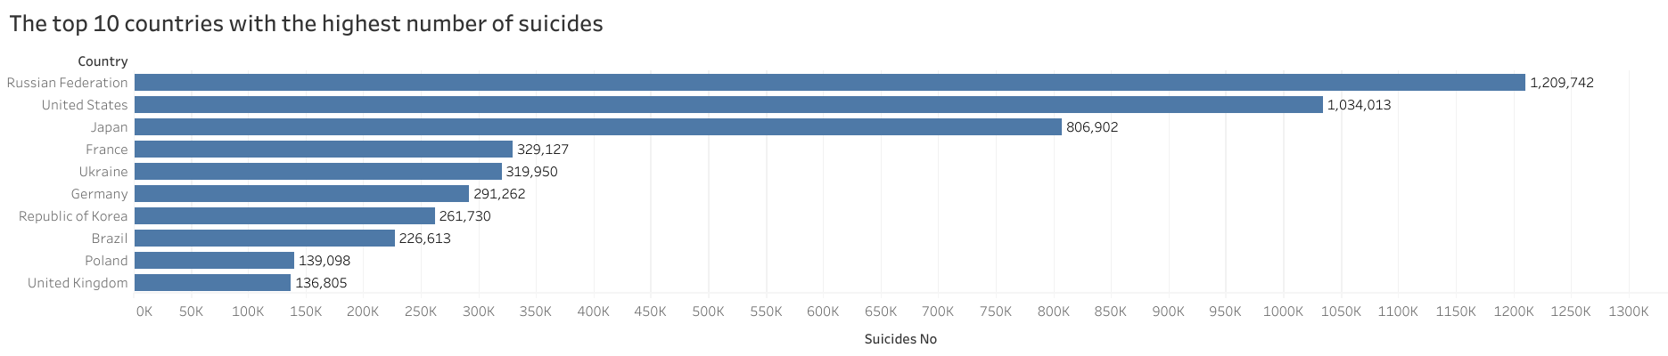
Top 10 Countries with Highest Suicide Numbers
Key Observations:
Russia has the highest number of suicides, followed by the United States and Japan.
The trend indicates a significant burden in developed and high-population countries.
France, Ukraine, and Germany also have considerable suicide rates.

Slide 3
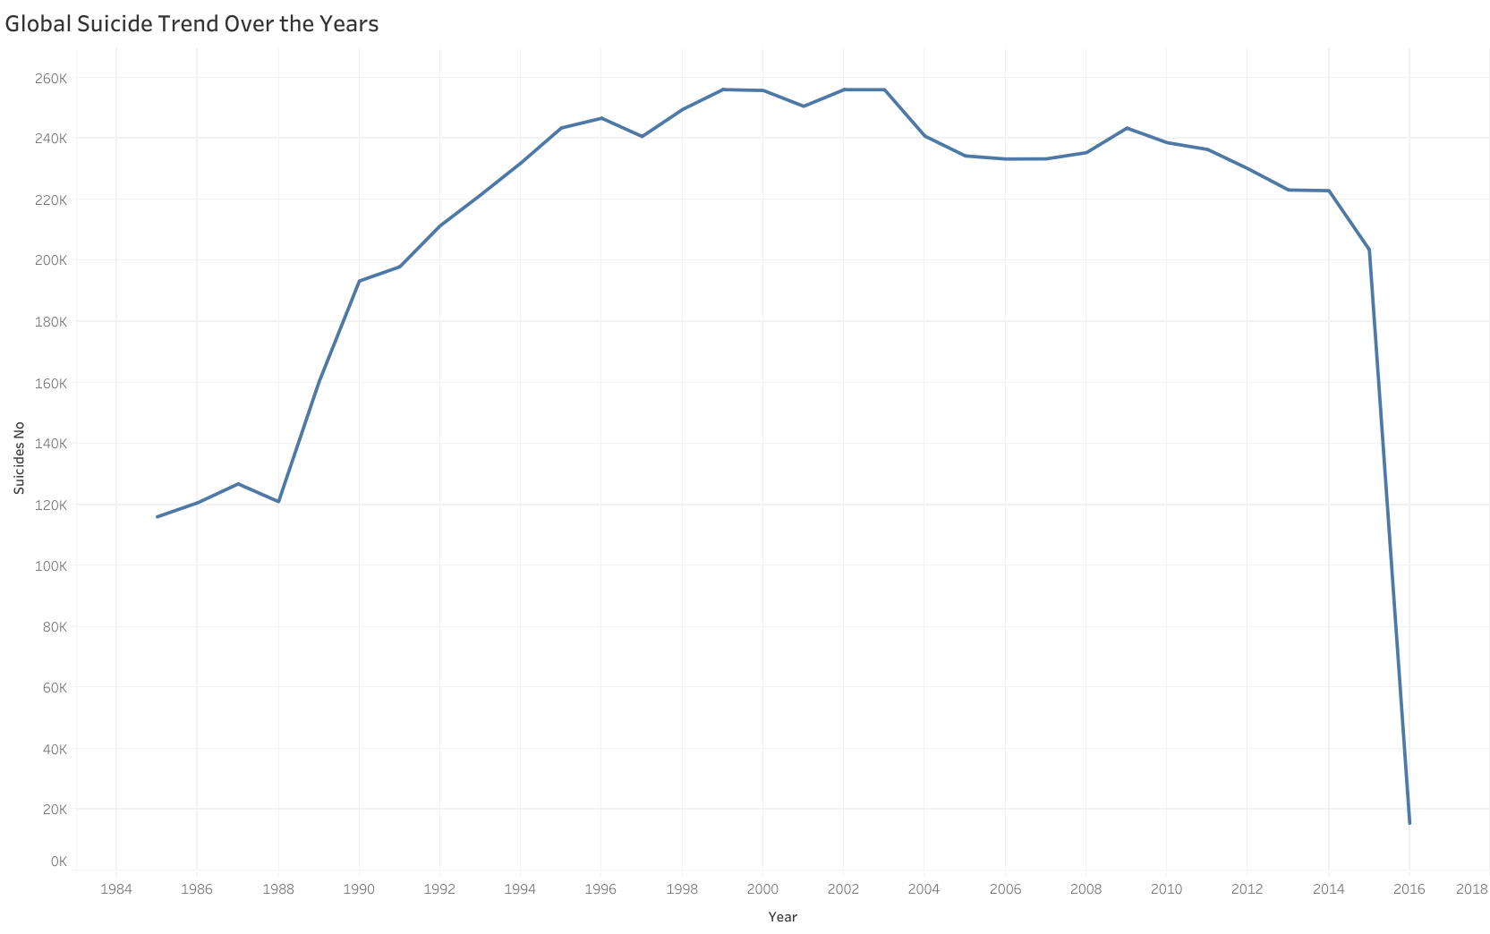
Global Suicide Trend Over the Years
Key Observations:
Suicide rates increased significantly from the mid-1980s to the early 2000s.
The peak was observed between 1995 and 2005.
There has been a declining trend since 2010.
The sharp drop in recent years might be due to incomplete data.

Slide 4
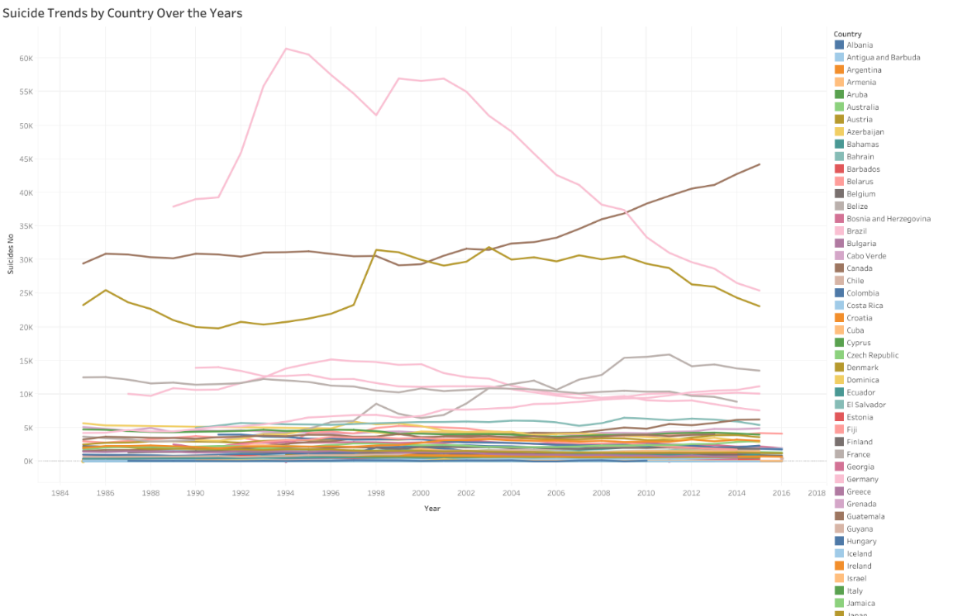
Suicide Trends by Country Over the Years
Key Observations:
Certain countries have distinct peaks, showing periods of crisis or economic struggles.
Some countries show a gradual increase or decrease in suicide rates.
There are visible variations, indicating that suicide trends are influenced by local factors.

Slide 5
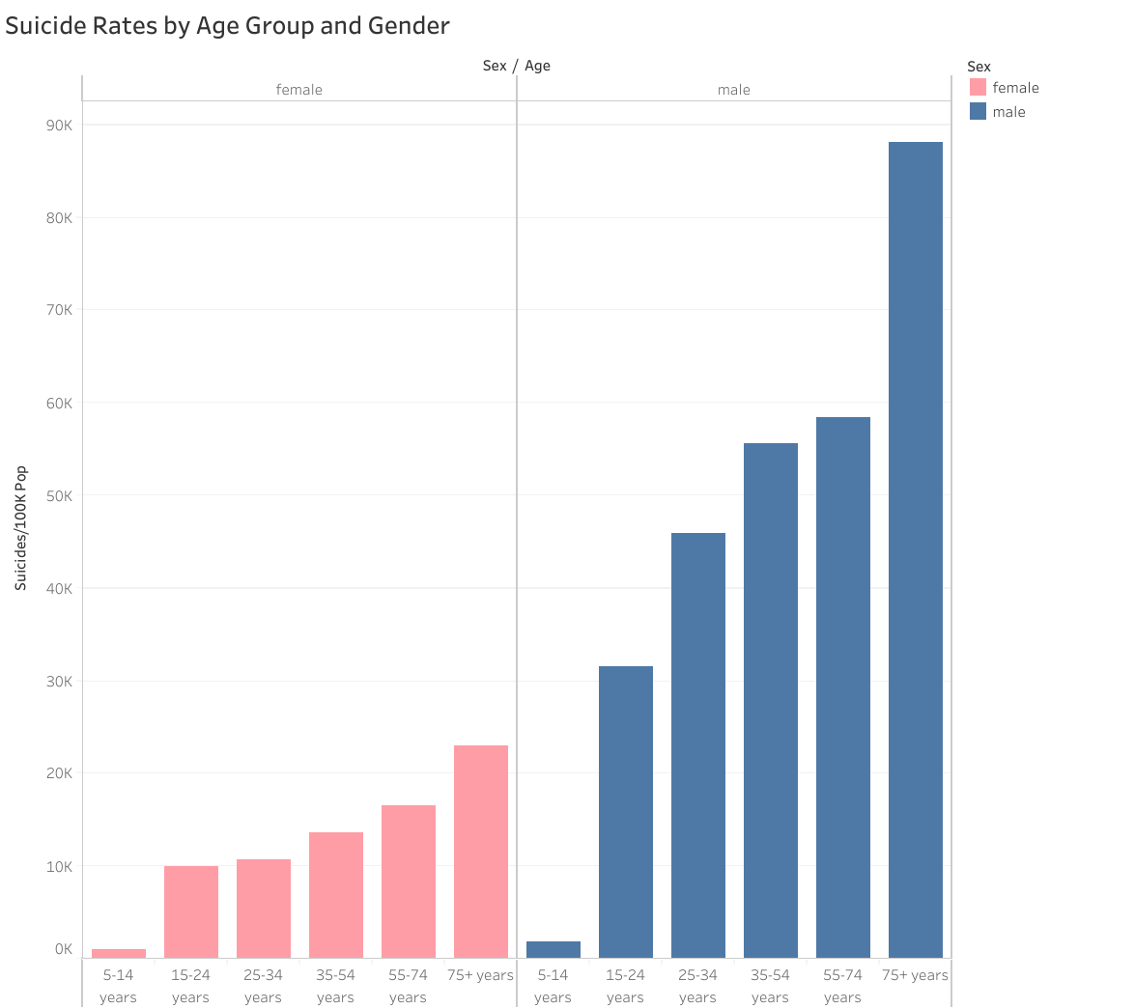
Suicide Rates by Age Group and Gender
Key Observations:
Suicide rates increase with age, with the highest rates in the 75+ years age group.
Males have significantly higher suicide rates than females across all age groups.
The gender gap in suicide rates becomes more pronounced in older age groups.

Slide 6
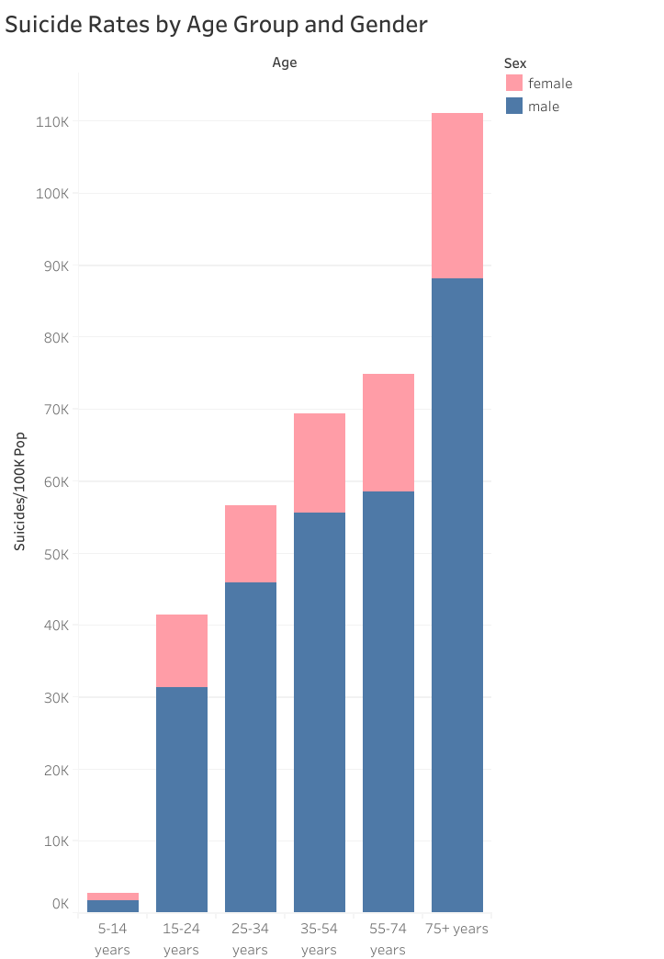
Suicide Rates by Age Group – Stacked View
Key Observations:
A stacked view provides a clearer comparison of total suicide rates in each age group.
Although male suicide rates are dominant, female suicide rates also rise with age.
A filter for year and country allows for further breakdowns in analysis.

Slide 7
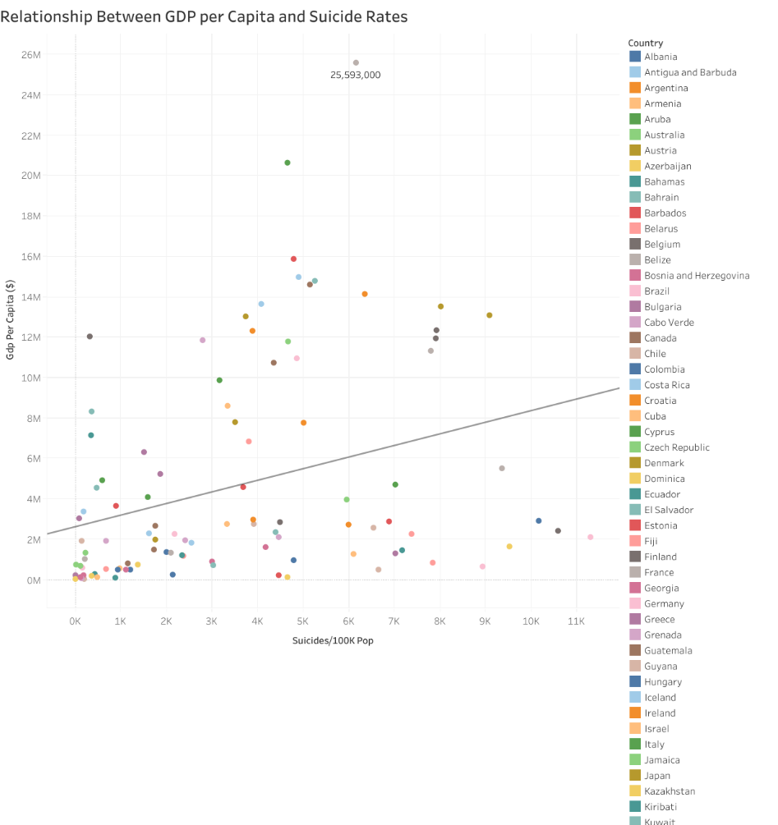
Relationship Between GDP per Capita and Suicide Rates
Key Observations:
The trend line suggests a weak positive correlation between GDP per capita and suicide rates.
Some high-GDP countries still experience high suicide rates, suggesting that economic prosperity alone does not prevent suicides.
Many low-GDP countries have lower suicide rates, but there are exceptions.
Country-level differences indicate that socio-cultural factors, mental health policies, and access to care play a crucial role.

Slide 8
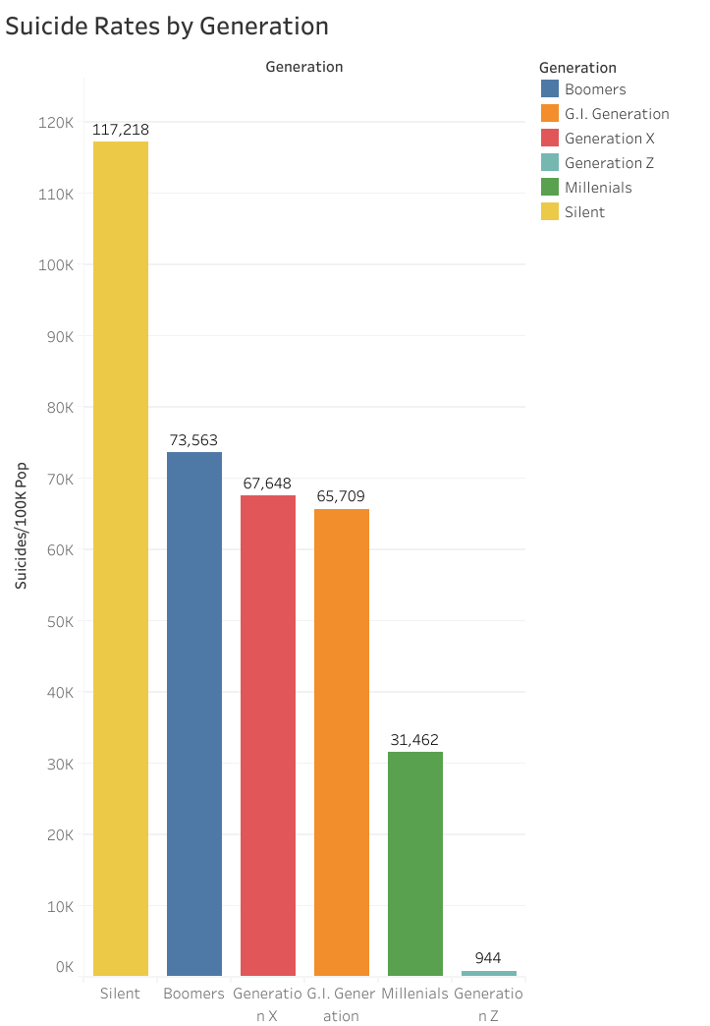
Suicide Rates by Generation
Key Observations:
The Silent Generation has the highest suicide rate, followed by the Boomers and Generation X.
Millennials and Generation Z have significantly lower suicide rates.
The trend may be influenced by mental health awareness, societal attitudes, and access to healthcare.

Slide 9
Suicide Rates by Generation filtered by years and country
Summary of Findings:
Suicide rates vary significantly by country, with Russia and the U.S. leading.
Global suicide rates peaked in the 1990s and have been declining since 2010.
Males are at much higher risk than females, especially in older age groups.
GDP per capita has only a weak correlation with suicide rates, suggesting social and mental health factors are more important.
The Silent Generation has the highest suicide rates, while younger generations report fewer suicides.
Recommendations for Prevention:
Improve mental health support for older adults, especially men.
Expand suicide prevention programs globally, targeting high-risk countries.
Increase investment in mental health awareness campaigns to reduce stigma.
Enhance access to crisis intervention and counseling services.

Slide 10
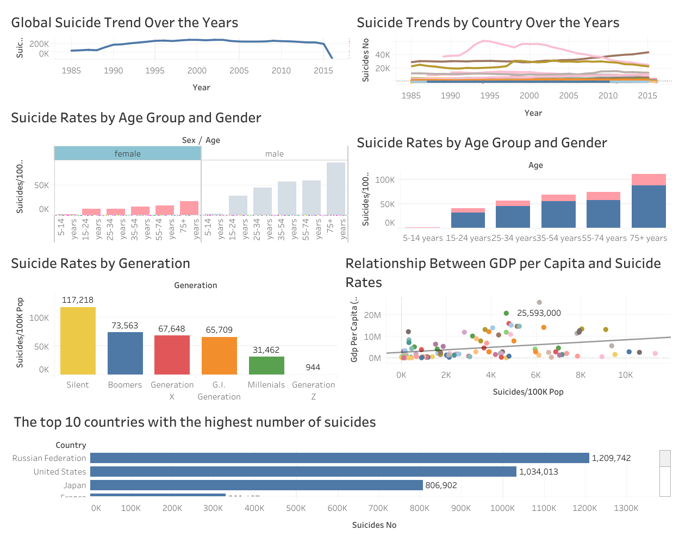
Dashboard Overview & Call to Action
Key Messages:
Mental health awareness saves lives.
Intervention strategies should be tailored to high-risk groups.
Socio-economic policies must address underlying stress factors.

Slide 11

THANK YOU !

